Slide 1

Smart Study Group Matching System Software Quality Assurance – SWE3020 Progress Presentation Group 2

Slide 2
What We Built
Automatically matches students into study groups
Matching criteria: shared course + topic difficulty + available time slots
Key constraints: no student in two groups at the same time, handles odd student counts
Built in Python; 42 automated tests written and passing
[Student Registers] → [Matching Engine] → [Group Assigned]

Slide 3
SQA Quality Objectives (McCall's Model)
Quality Factor | What it means for our system
Correctness | Matching output must follow defined rules exactly
Reliability | System must not crash on odd counts or empty inputs
Usability | Students complete registration without confusion
Testability | Modules structured for independent unit testing
Maintainability | Code is modular and documented for future changes

Slide 4
SQA Plan – Six Standards Areas
Coding Standards — snake_case naming, max 30 lines per function, no hardcoded values
Database Design Standards — 3NF normalisation, unique constraint: no student in two groups at same time slot
GUI Design Standards — course selection via dropdown, meaningful error messages
Testing Standards — EP, BVA, CFG; every branch covered;test IDs trace to requirements
Review Standards — peer review checklist, walkthroughbefore each test phase
Org. Process Reference — aligned to IEEE SQA definition

Slide 5
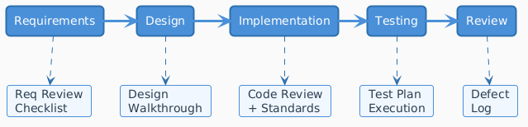
SQA Integrated Into the Project Lifecycle

Slide 6
Two-Track Testing Approach
 | Black Box | White Box
View | External behaviour | Internal structure
Techniques | EP + BVA | CFG + Branch Coverage + DU Analysis
What it finds | Wrong outputs, missing validations | Untested branches, variable lifecycle bugs
Applied to | Course matching, group size, conflicts, odd counts | match_students() and has_time_conflict()

Slide 7
Black Box – Equivalence Partitioning
Partition | Input | Expected Output
Valid – same course | Student A + B: COMP101 | Group formed ✓
Invalid – different course | A: COMP101, B: MATH201 | No match ✓
Invalid – no course | A: (none) | Validation error ✓
Example — Course Matching:

Slide 8
Black Box – Equivalence Partitioning
Partition | Range | Representative | Expected
Too few | 0–1 | 1 student | Waitlisted
Valid | 2–5 | 3 students | Group formed
Too many | > 5 | 7 students | Split / waitlist
Example — Group Size:

Slide 9
Black Box – Boundary Value Analysis
Test ID | Input | Boundary Position | Expected
BVA-G2 | 1 student | Just below min | Waitlisted
BVA-G3 | 2 students | At minimum | Group formed
BVA-G5 | 5 students | At maximum | Group formed
BVA-G6 | 6 students | Just above max | Split/waitlist
Group Size Boundaries (GROUP_SIZE_MIN = 2, MAX = 5):

Slide 10
Black Box – Boundary Value Analysis
Test ID | Input | Expected
BVA-O2 | 2 students | 1 group of 2
BVA-O3 | 3 students | 1 group + 1 waitlisted
BVA-O4 | 5 students | 2 groups, 0 waitlisted
Odd Student Boundaries:

Slide 11
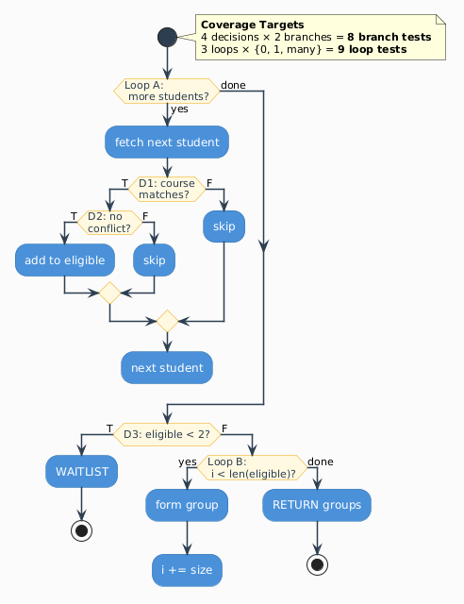
White Box – Control Flow Graph

Slide 12
White Box – Branch Coverage (Level 2)
Decision | True Branch Test | False Branch Test
D1: course match | A enrolled in COMP101 ✓ | A enrolled in MATH201 ✓
D2: no conflict | A free at MON-09:00 ✓ | A already in MON-09:00 group ✓
D3: eligible < 2 | Only 1 eligible student ✓ | 3 eligible students ✓
D4: slot match | Group slot = proposed ✓ | Group slot ≠ proposed ✓
Content:

Slide 13
White Box – Branch Coverage (Level 2)
Loop | 0 iterations | 1 iteration | Multiple
Loop A (students) | Empty list ✓ | 1 student ✓ | 5 students ✓
Loop B (group formation) | Caught by D3 | 2 students → 1 group ✓ | 6 students → 3 groups ✓
Loop C (conflict check) | No assigned groups ✓ | 1 group ✓ | 3 groups ✓
Content:

Slide 14
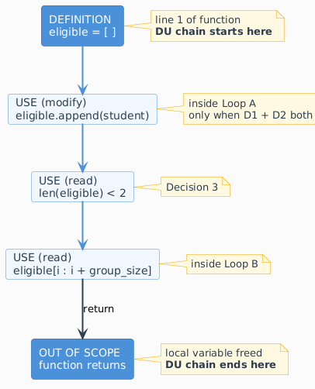
White Box – Data Flow Analysis (eligible variable)

Slide 15
White Box – Data Flow Analysis (eligible variable)
Abnormal Pair | Found?
Use before definition | No ✗
Overwrite before use | No ✗
Use after deletion | No ✗
Defined but never used | No ✗
Abnormal pairs checked:

Slide 16
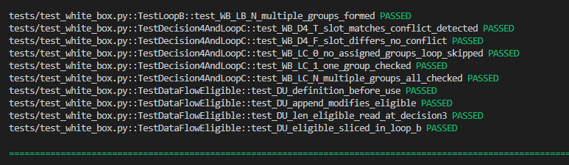
42 Tests – All Passing

